Slide 1
18CSC305J Artificial Intelligence
Project presentation

Slide 2
Project title – FACE MASK DETECTION
Submitted by
NILAY (RA2011033010056)
KARAN KESHRI (RA2011033010044)
AMIT KUMAR JHA (RA2011033010049)

Slide 3
INDEX
USE-CASE, CLASS, ARCHITECTURE DIAGRAMS
SEQUENCE DIAGRAM
METHODOLOGY
CONCLUSION
ABSTRACT
PROBLEM STATEMENT
LITERATURE SURVEY
BENEFITS
LIMITATIONS
ALGORITHM
MODULE

Slide 4
ABSTRACT
COVID-19 pandemic has rapidly affected our day-to-day life disrupting the world trade and movements. Wearing a protective face mask has become a new normal. In the near future, many public service providers will ask the customers to wear masks correctly to avail of their services. Therefore, face mask detection has become a crucial task to help global society.
This project presents a simplified approach to achieve this purpose using some basic Machine Learning packages like TensorFlow, Keras, OpenCV. The proposed method detects the face from the image correctly and then identifies if it has a mask on it or not. As a surveillance task performer, it can also detect a face along with a mask in motion. The method attains accuracy up to 97.77% respectively on two different datasets. We explore optimized values of parameters using the Sequential Convolutional Neural Network model to detect the presence of masks correctly without causing over-fitting.

Slide 5
PROBLEM STATEMENT
The main objective of the face detection model is to detect the face of individuals and conclude whether they are wearing masks or not at that particular moment when they are captured in the image or in Video.
With the advancements in technology that the world has been witnessing, there are various available techniques that could prove valuable to society if used effectively. A real-time system which could itself classify, seeing a person, in two categories :
1. A person wearing a face mask.
2. A person not wearing a face mask.

Slide 6
LITERATURE SURVEY
"Real-Time Face Mask Detection using Deep Learning and OpenCV" (2020) by K. Balakrishnan et al. This paper proposes a real-time face mask detection system using OpenCV and deep learning algorithms. The system achieved a high accuracy rate of 97.6% and was able to detect faces and classify them as wearing a mask or not wearing a mask in real-time.
"Face Mask Detection using Convolutional Neural Networks and Support Vector Machines" (2021) by P. Shinde et al. This paper proposes a face mask detection system using convolutional neural networks (CNNs) and support vector machines (SVMs). The system achieved an accuracy rate of 96.9% and was able to classify face images as wearing a mask or not wearing a mask.

Slide 7
Research Paper | Techniques/Models Used | Dataset Used | Accuracy
"Real-time face mask detection using deep learning neural network" (2020) by A. Alomari et al. | MobileNetV2, TensorFlow Lite | Custom dataset of 5,000 images | 97.5%
"Automated face mask detection system based on deep learning and machine learning algorithms" (2021) by T. Alghamdi et al. | ResNet50, SVM, kNN | Custom dataset of 2,000 images | 97.4%
"Masked face recognition dataset and application" (2020) by S. Afifi et al. | MobileNetV2, VGG16, ResNet50 | Custom dataset of 7,000 images | 99.7%
"Real-time face mask detection using convolutional neural networks and transfer learning" (2021) by Y. Yan et al. | InceptionV3, TensorFlow | Custom dataset of 2,000 images | 96.3%
"An intelligent face mask detection system for COVID-19" (2021) by M. Gupta et al. | ResNet50, SVM, kNN, Naïve Bayes | Custom dataset of 1,500 images | 94.8%

Slide 8
ALGORITHM
In this project,we will use YOLO algorithm.
YOLO algorithm is important because of the following reasons:
Speed: This algorithm improves the speed of detection because it can predict objects in real-time.
High accuracy: YOLO is a predictive technique that provides accurate results with minimal background errors.
Learning capabilities: The algorithm has excellent learning capabilities that enable it to learn the representations of objects and apply them in object detection.

Slide 9
LIMITATIONS
Involve too many machine learning concepts and complexities.
Due to camera quality or low face visibility it might be chances that
it will lead issue in detects face.
High setup cost.

Slide 10
BENEFITS
This will help many organization to detect whether people are wearing facemask or not.
This will be helpful to implement government protocol.
This will reduce manual labour cost.

Slide 11
MODULES
Image Acquisition Module
Preprocessing Module
Face Detection Module
Face Mask Classification Module
Alert Module
Database Module
User Interface Module
Deployment Module

Slide 12
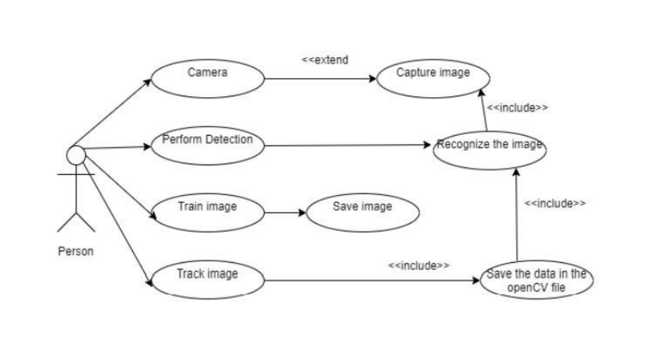
USECASE DIAGRAM

Slide 13
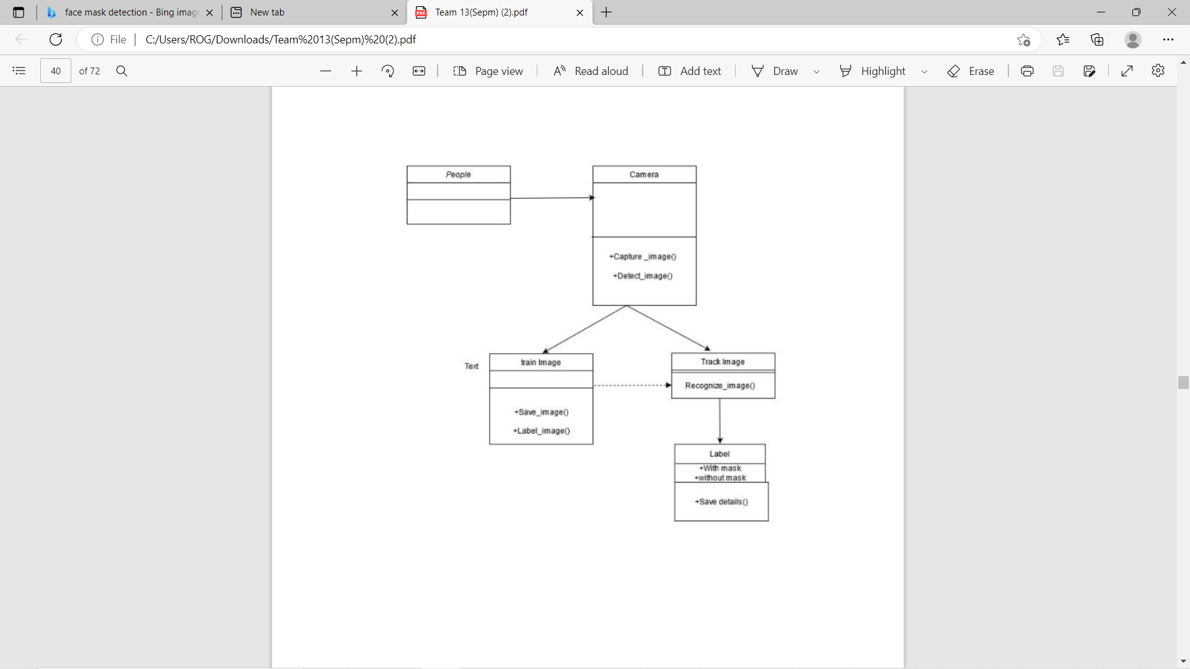
CLASS DIAGRAM

Slide 14
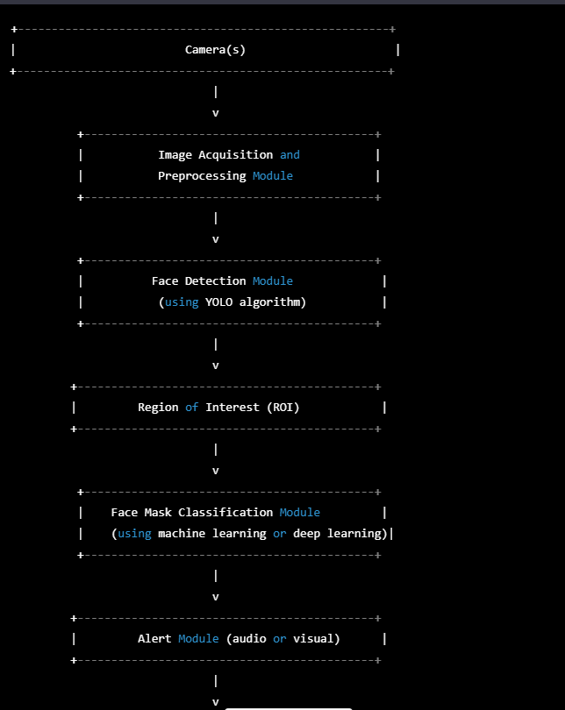
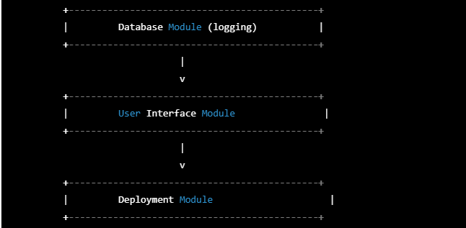
ARCHITECTURE DIAGRAM

Slide 15
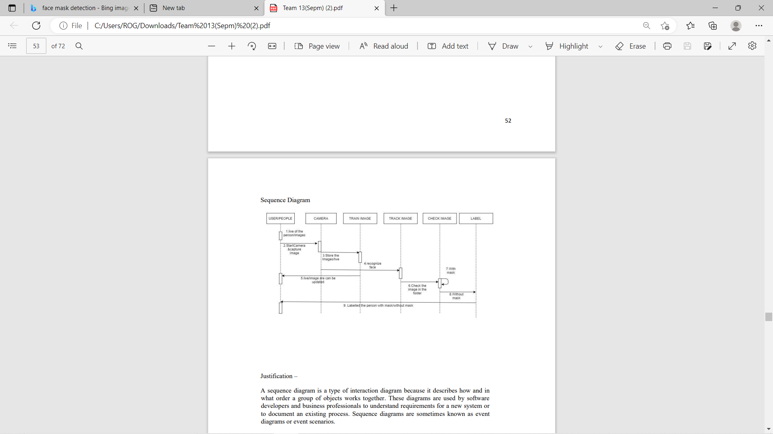
SEQUENCE DIAGRAM

Slide 16
METHODODLOGY
Data Collection
Preprocessing
Face Detection
Face Mask Classification
Alert Generation
Database Management
User Interface
Deployment
Maintenance

Slide 17
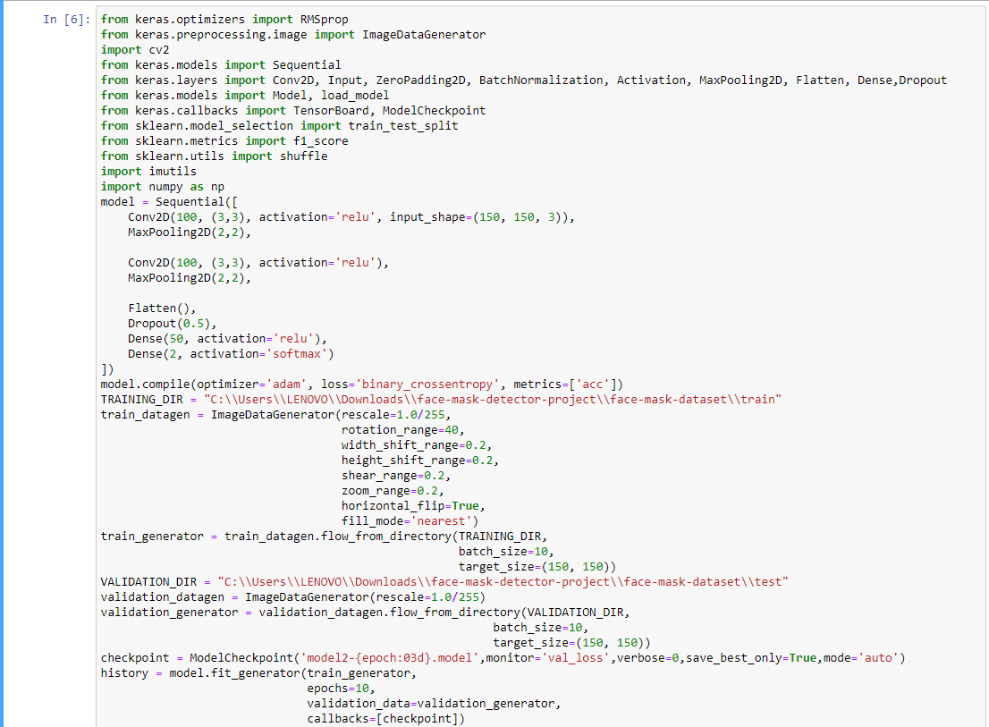
CODE FOR TRAINING AND TESTING THE DATASET

Slide 18
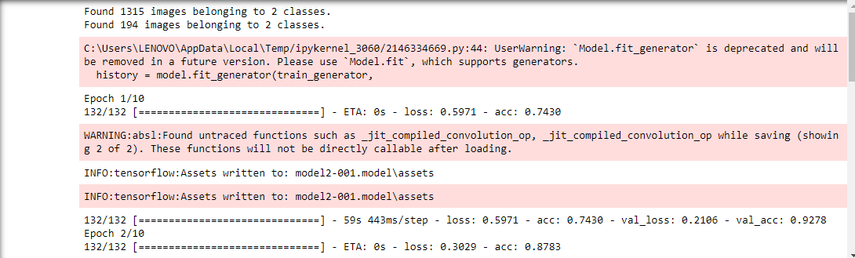
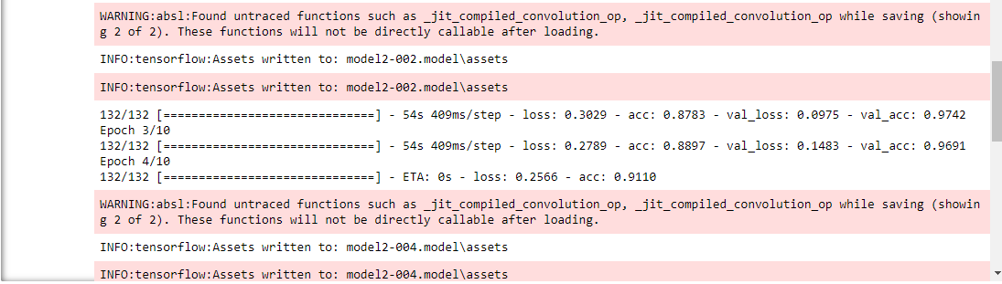
OUTPUT FOR TRAINING MODEL

Slide 19
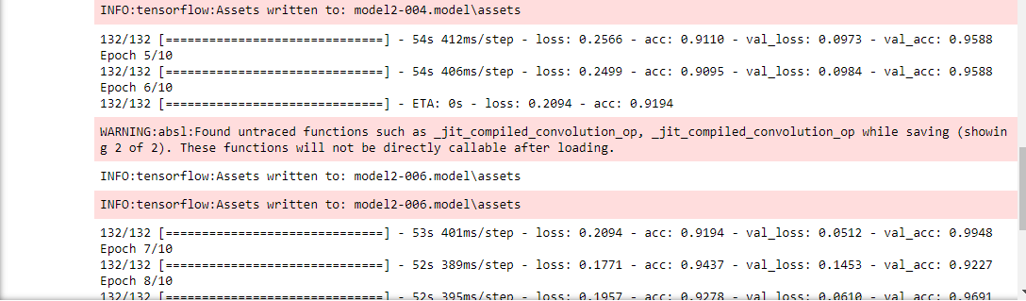
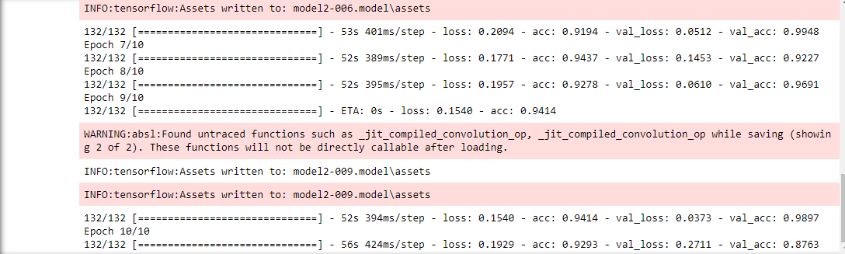

Slide 20
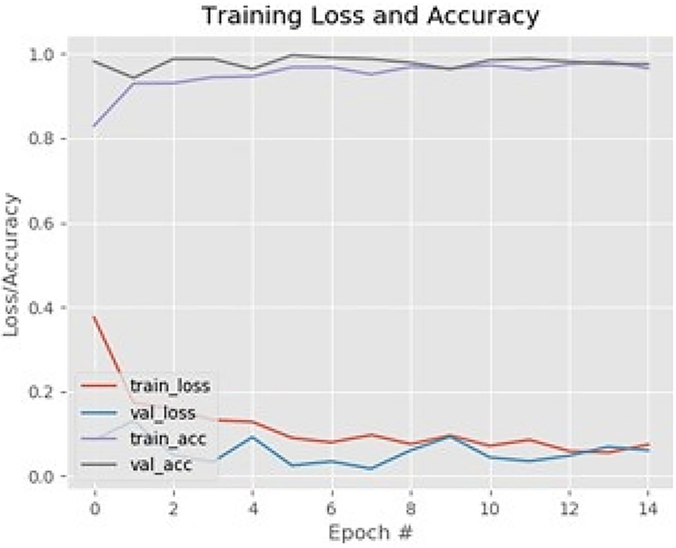
GRAPH FOR TRAINING THE MODEL

Slide 21
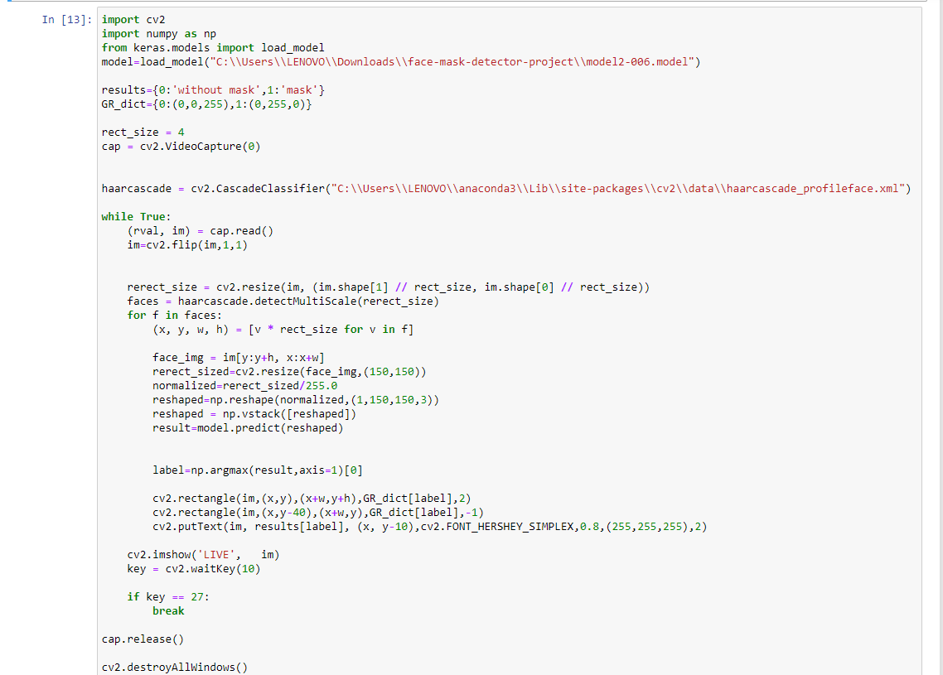
CODE FOR IMPLEMENTATION

Slide 22
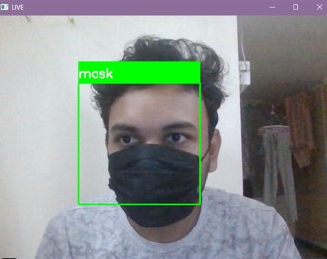
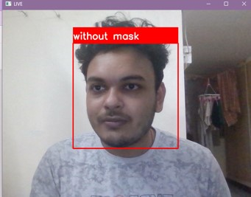
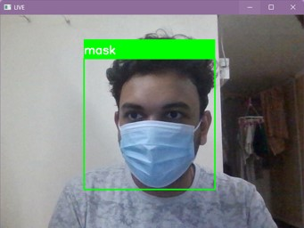
OUTPUT
WITH MASK
WITHOUT MASK

Slide 23
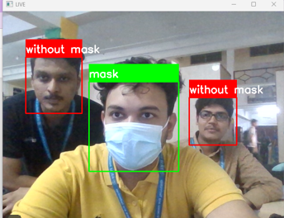
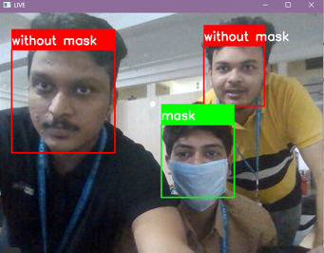
OUTPUT

Slide 24
CONCLUSION
As the technology are blooming with emerging trends the availability so we have novel face mask detector which can possibly contribute to public healthcare. The architecture consists of Mobile Net as the backbone it can be used for high and low computation scenarios. In order to extract more robust features, we utilize transfer learning to adopt weights from a similar task face detection, which is trained on a very large dataset. We used OpenCV, tensor flow, and NN to detect whether people were wearing face masks or not. The models were tested with images and real-time video streams. The accuracy of the model is achieved and, the optimization of the model is a continuous process and we are building a highly accurate solution by tuning the hyper parameters. This specific model could be used as a use case for edge analytics. Furthermore, the proposed method achieves state-of-the-art results on a public face mask dataset. By the development of face mask-detection we can detect if the person is wearing a face mask and allow their entry would be of great help to the society

Slide 25
REFERENCE
https://www.geeksforgeeks.org/facemask-detection-using-tensorflow-in-python/
https://www.geeksforgeeks.org/yolo-you-only-look-once-real-time-object-detection/
https://www.kaggle.com/datasets/andrewmvd/face-mask-detection
https://github.com/nilay4642/A.I-Face-mask-detection-project

